Slide 1

Comparative Study of PID and State-Space Pole Placement Control for a Differential Drive Mobile Robot
UNIVERSITY OF DEBRECEN • FACULTY OF ENGINEERING • DEPARTMENT OF MECHATRONICS
Project of Mechatronics
Author: Mohammed Emad Said Soliman Mohammed (UHCI4H)
Supervisors: Kis Károly Árpád
Department of Electrical Engineering and Mechatronics

Slide 2

SECTION 1 • PRESENTATION OUTLINE
Content of the Presentation
01
02
03
04
Problem & Task
Applied Principles
Physical Solution
Results & Future
Simulation-to-reality gap in mobile robotics.
3-DoF kinematics, PID, State-Space observer.
Simscape Multibody, DC motors, H-bridge.
Figure-8 metrics, conclusions, hardware plan.

Slide 3
SECTION 2 • PROBLEM PROPOSITION (1/2)
Ideal Theory vs. Physical Reality
Ideal Kinematic Simulation
Real Mechatronic Hardware
•
Pure Rolling Contact: Assumes zero longitudinal or lateral wheel slip.
•
Multibody Contact Forces: Tire stiffness, damping, ground friction slip.
•
Zero Inertial Delay: Neglects chassis mass and wheel rotational inertia.
•
Electromechanical Lag: Cascaded DC motor torque and rotor inertia.
•
Instant Actuation: Commands wheel velocities without electrical lag.
•
Power Electronics Limits: H-bridge PWM switching and battery voltage drop.
•
PID Bias: Classical PID appears stable under idealized conditions.
•
Coupled Instability: Unmodeled delays cause severe trajectory chatter.

Slide 4
SECTION 2 • THE TASK TO BE SOLVED (2/2)
Chronological Engineering Methodology
•
Stage 1 — Mathematical Modeling: Formulate 3-DoF differential drive kinematics and validate in Simulink .
•
Stage 2 — Ideal Control Design: Test decoupled parallel PID versus State-Space pole placement with Luenberger observer .
•
Stage 3 — 3D Simscape Multibody: Add rigid-body inertia, passive caster stability, revolute joints, and wheel-ground friction .
•
Stage 4 — Cascaded Motor Loop: Couple outer path controllers with tuned inner-loop DC motor velocity PID controllers.
•
Stage 5 — Hardware Limitations: Integrate non-ideal battery and H-bridge PWM drivers over a 30 s figure-8 track.

Slide 5
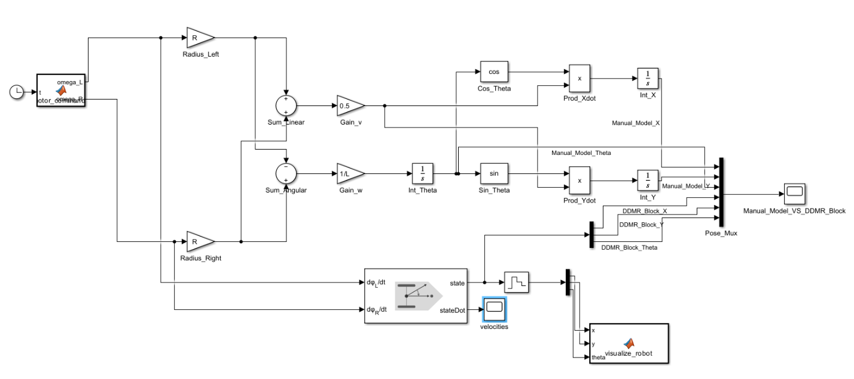
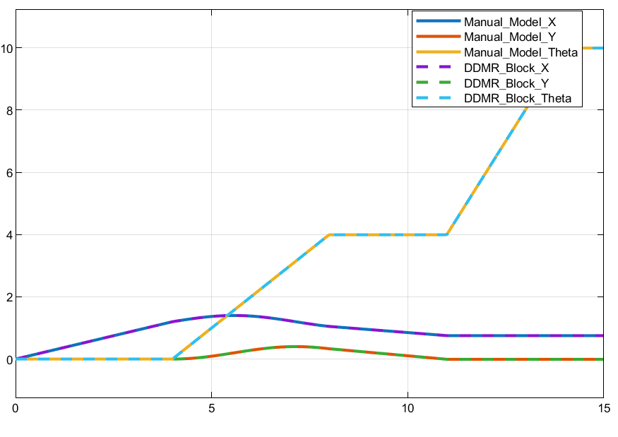
SECTION 3 • APPLIED PRINCIPLES & DERIVATIONS (1/3)
Step 1: 3-DoF Kinematics & Validation
Kinematic Equations

Slide 6
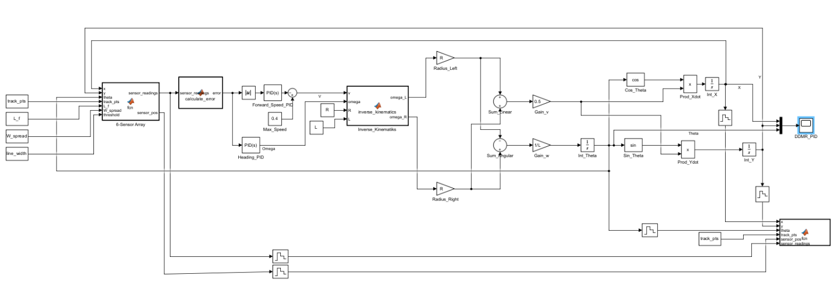
SECTION 3 • APPLIED PRINCIPLES & DERIVATIONS (2/3)
Step 2A: Parallel PID Controller Design
Braking PID: (5, 0, 0) • Heading PID: (50, 0.001, 0)

Slide 7
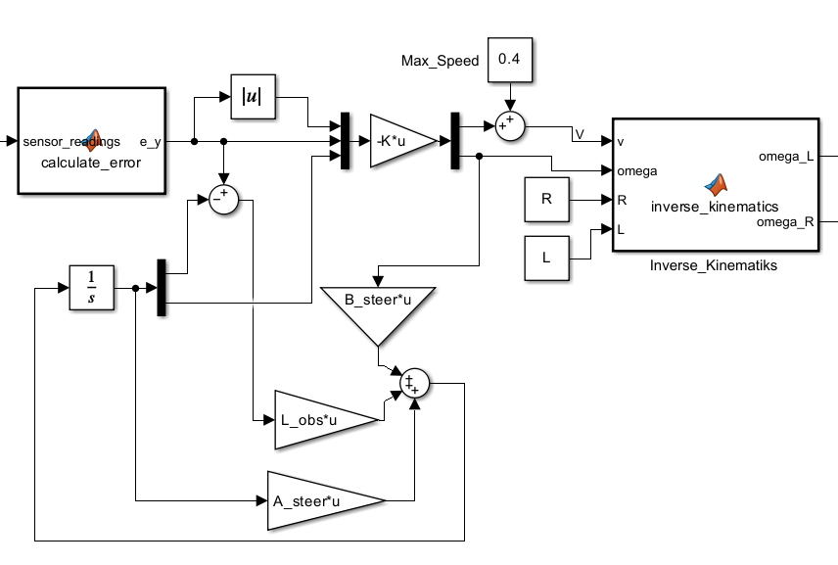
SECTION 3 • APPLIED PRINCIPLES & DERIVATIONS (3/3)
Step 2B: State-Space & Luenberger Observer
Observer & Pole Placement
Initial Chosen Poles: [-0.9, -1.89]

Slide 8
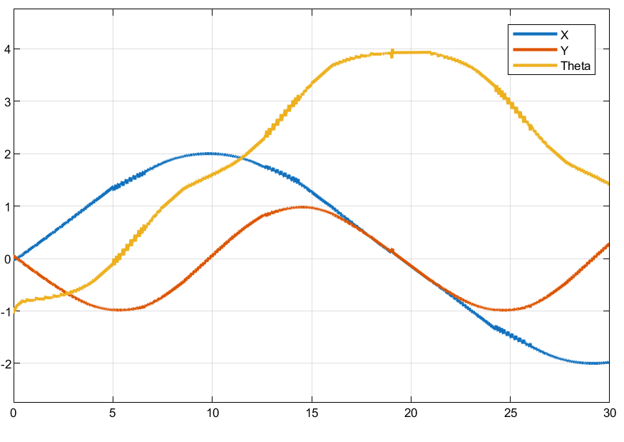
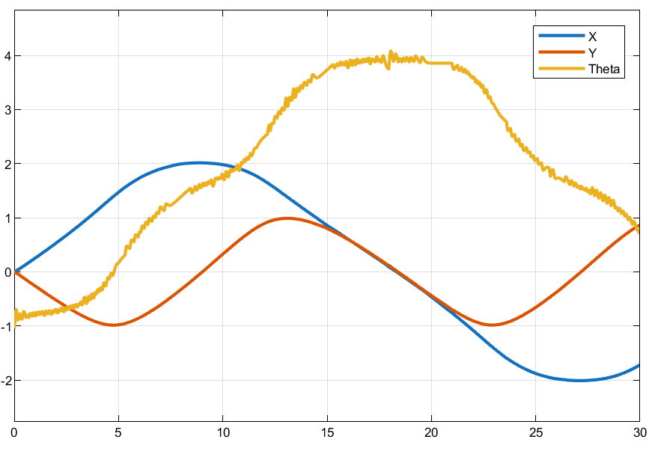
SECTION 3 • IDEAL MATHEMATICAL MODEL RESULTS
Basic Math Model Graphs: PID vs. State-Space
Ideal PID Response
Ideal State-Space Response
Follows crossover geometry with high-frequency micro-chatter.
Completes figure-8 path with slight heading wobble on turns.

Slide 9
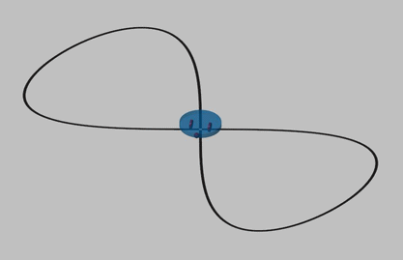
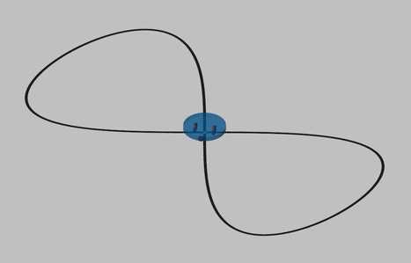
SECTION 3 • IDEAL MATHEMATICAL MODEL VIDEOS
Video Demonstration: Basic Math Models
PID Mathematical Model
State-Space Mathematical Model
Pure kinematic tracking at 0.40 m/s nominal velocity.
Pole placement with Luenberger observer state feedback.

Slide 10
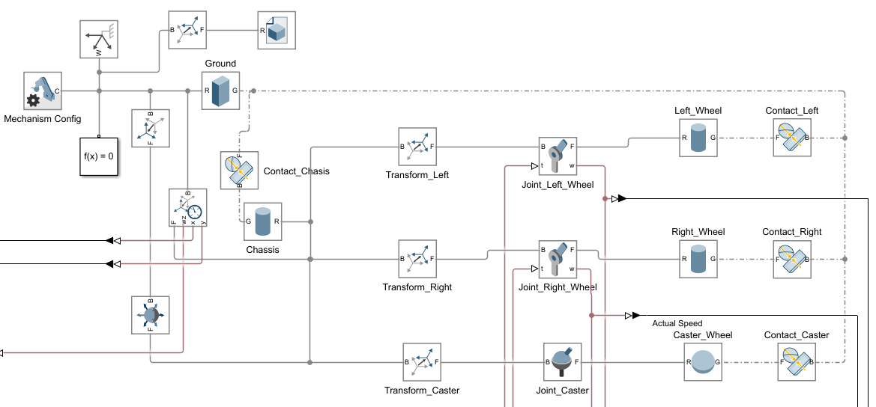
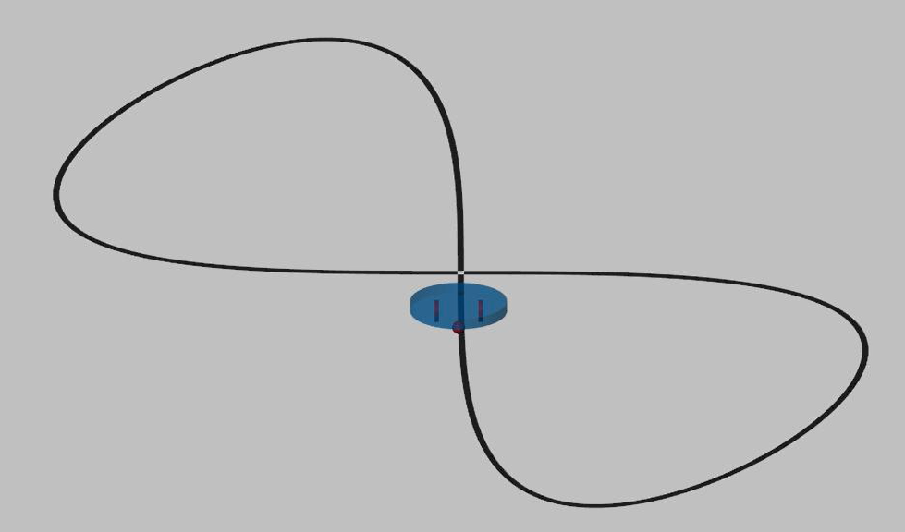
SECTION 4 • INTRODUCTION OF THE SOLUTION (1/3)
Step 3: 3D Simscape Multibody Model
Multibody Plant Topology
3D Physical Visualization
Revolute drive joints, spherical caster, spatial contact forces.
Cylindrical chassis with two drive wheels and passive caster.

Slide 11
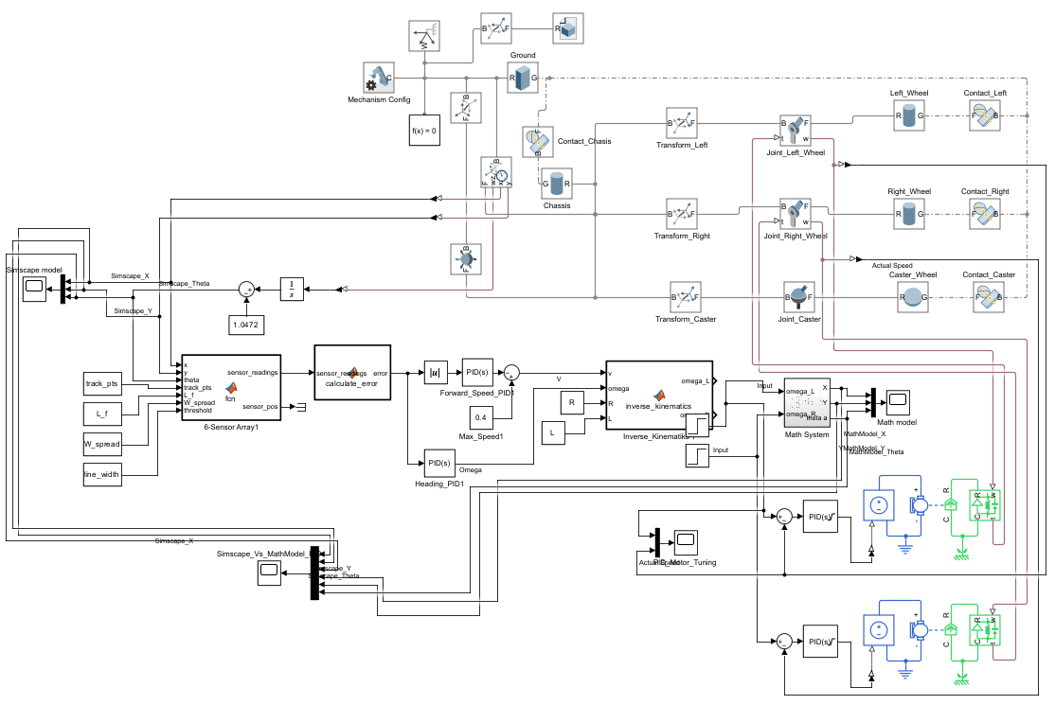
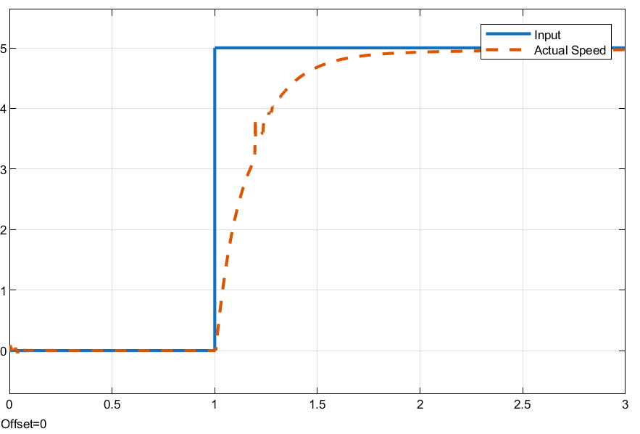
SECTION 4 • INTRODUCTION OF THE SOLUTION (2/3)
Step 4: Cascaded Motor Models & Tuning
Cascaded Models
Figure 10: Motor Step
Outer path loop drives inner wheel PIDs.
Fast 5 rad/s settling without overshoot.

Slide 12
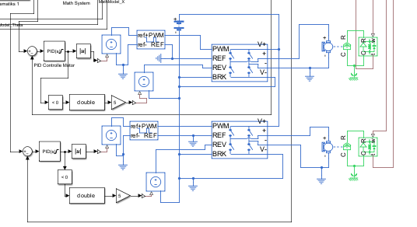
SECTION 4 • INTRODUCTION OF THE SOLUTION (3/3)
Step 5: H-Bridge & Battery Integration
Hardware Retuning: PID forced down to 0.30 m/s; State-Space kept 0.40 m/s with poles shifted to [-4, -5].

Slide 13
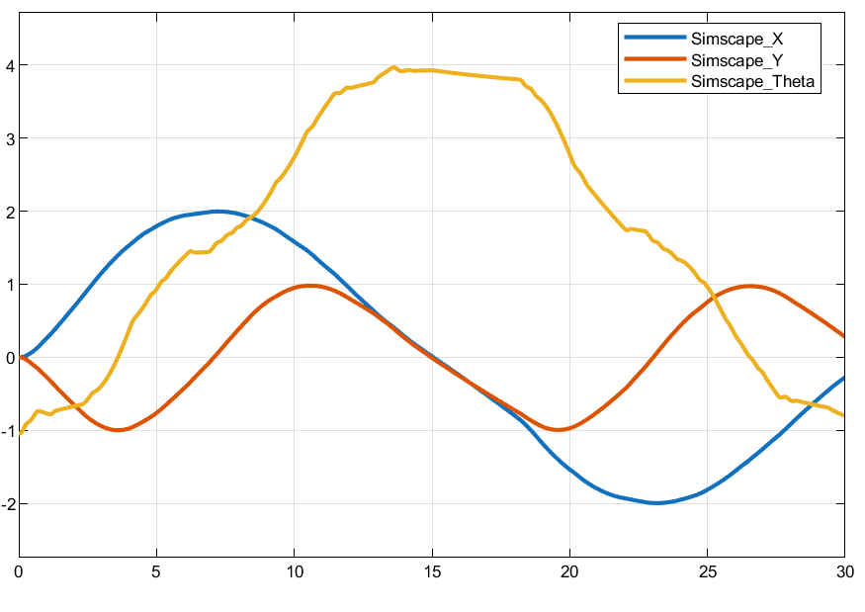
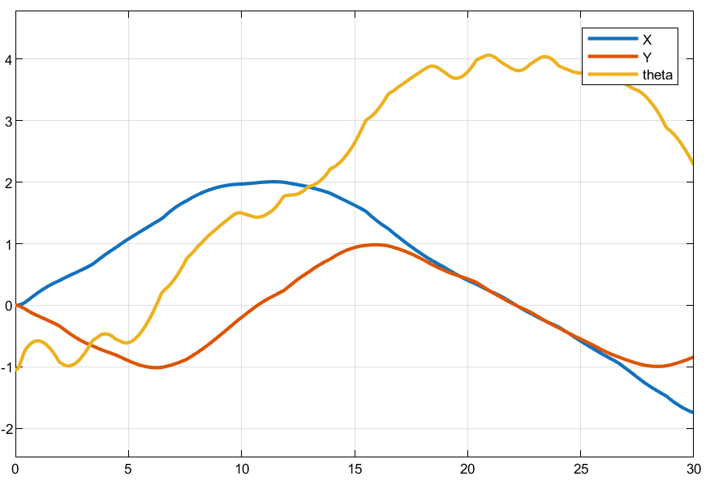
SECTION 5 • THE RESULTS ACHIEVED (1/2)
Final Model Graphs: H-Bridge, Battery & Motor
Final State-Space (0.40 m/s)
Final PID (0.30 m/s)
Smooth trajectory tracking; travels farther in 30 s with poles [-4, -5].
Significant wobble and chatter despite reduced 0.30 m/s speed.

Slide 14
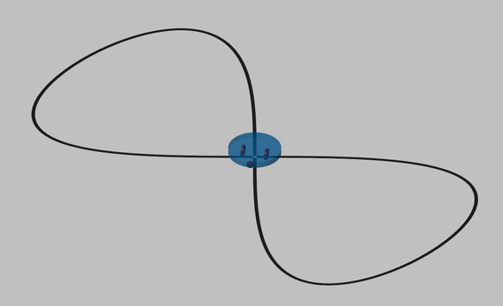
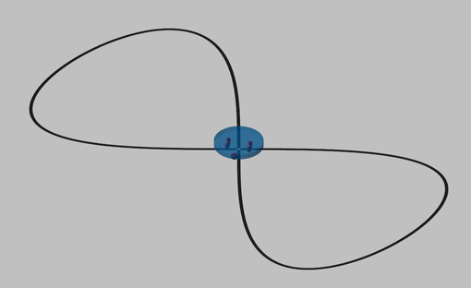
SECTION 5 • THE RESULTS ACHIEVED (2/2)
Video Demonstration: Final Hardware Models
[ INSERT VIDEO 3: FINAL PID SIMSCAPE ]
[ INSERT VIDEO 4: FINAL STATE-SPACE SIMSCAPE ]
Simscape + H-Bridge + Battery + DC Motor
Simscape + H-Bridge + Battery + DC Motor
Final PID Hardware Simulation
Final State-Space Hardware Simulation
Reduced to 0.30 m/s (1.08 km/h) with visible trajectory wobble.
Maintains full 0.40 m/s (1.44 km/h) with smooth path tracking.

Slide 15
SECTION 6 • CONCLUSIONS & FURTHER IMPROVEMENTS
Conclusions & Proposed Solutions
Simulation vs. Reality
State-Space Robustness
Ideal models overestimate classical PID stability.
Full-state feedback compensates electromechanical lag.
Ziegler-Nichols & Pole Tuning
Wheel Slip scenarios
Optimize PID and State-Space gains numerically.
Add more realism by including some friction lacking surfaces

Slide 16

SECTION 7 • APPRECIATION & ACKNOWLEDGMENT
Thank You for Your Attention!
I would like to express my sincere gratitude to my supervisor, Kis Károly Árpád for his invaluable guidance, patience, and support throughout this work.
Mohammed Emad Said Soliman Mohammed (UHCI4H)
University of Debrecen • Faculty of Engineering • mohammed.emad@mailbox.unideb.hu

